Slide 1
HTTP JSON API Node.js Server
Hanyu Cheng
19586

Slide 2
Introduction

Slide 3
Basic Infomation
This project is using Node.js to run a time server by using JSON API to tell the user what is the current time.
There are two part: server scripts, and website display.

Slide 4
Server Scripts

Slide 5
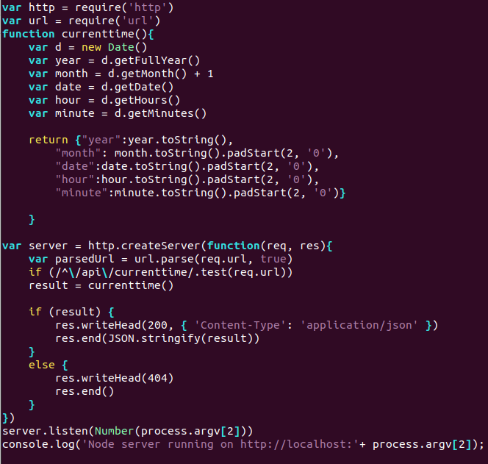
time_server.js

Slide 6
Website

Slide 7
Url
http://localhost:8000/api/currenttime

Slide 8
Expected Display
{"year":2021,
"Month":09,
"Date":24,
"Hour":16,
"minute":09}

Slide 9
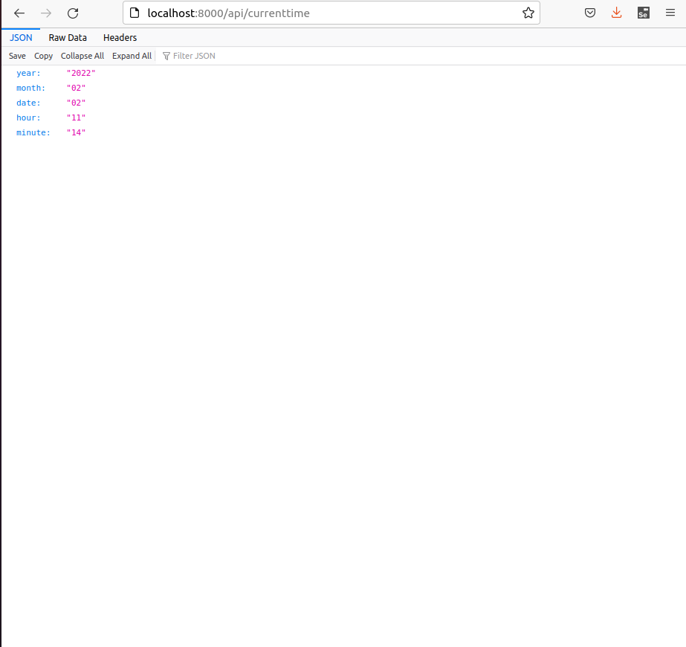
Website

Slide 10
Thank you

